Slide 1

THE ART OF COFFEE EMTREPRENEURSHIP
NAME: JIHANA AKTER LISA
DEPARTMENT: PHYSICS
BATCH NO: 20
DATE: 06-10-24

Slide 2

Lisa's Latte Lounge is a cozy and welcoming coffee shop that offers a unique blend of artisanal coffee, friendly service, and a relaxing atmosphere. Established to bring together coffee enthusiasts, it specializes in freshly brewed, high-quality coffee beverages made from sustainably sourced beans. The lounge prides itself on creating a perfect environment for work, relaxation, and socializing. With a wide range of specialty coffees, teas, and freshly baked goods, Lisa’s Latte Lounge has become a favorite spot for locals seeking quality and comfort.
ABOUT OF MY COFFEE SHOP

Slide 3
Products : 1. Artisanal Coffee: Premium blends like espresso, cappuccino, and cold brew. 2. Specialty Drinks: Seasonal lattes, frappés, and tea infusions. 3. Fresh Baked Goods: Daily pastries, muffins, and cakes. 4. Healthy Snacks: Smoothies, granola bars, and yogurt parfaits.
PRODUCTS AND SERVICES
ESPRESSO
LATTE
MOCHA

Slide 4

Services : 1. Cozy Atmosphere: Free Wi-Fi, comfortable seating for work or relaxation. 2. Custom Orders: Plant-based options and personalized coffee choices. 3. Catering Services: Coffee and baked goods for events and meetings. 4. Merchandise: Branded mugs, reusable cups, and coffee beans
PRODUCTS AND SERVICES
Video

Slide 5
SALES AND COSTS
Month | Sales Revenue ($) | Cost of Goods Sold (COGS) ($) | Labor Cost ($) | Rent and Utilities ($) | Marketing ($) | Net Profit ($)
January | 5000 | 2000 | 1500 | 500 | 300 | 1500
February | 6000 | 2500 | 2000 | 700 | 800 | 1900
March | 7500 | 3000 | 2200 | 1000 | 850 | 2800
April | 8000 | 3200 | 2500 | 2000 | 900 | 3000
May | 9500 | 3500 | 3000 | 2500 | 1000 | 4200

Slide 6
SALES AND COSTS

Slide 7
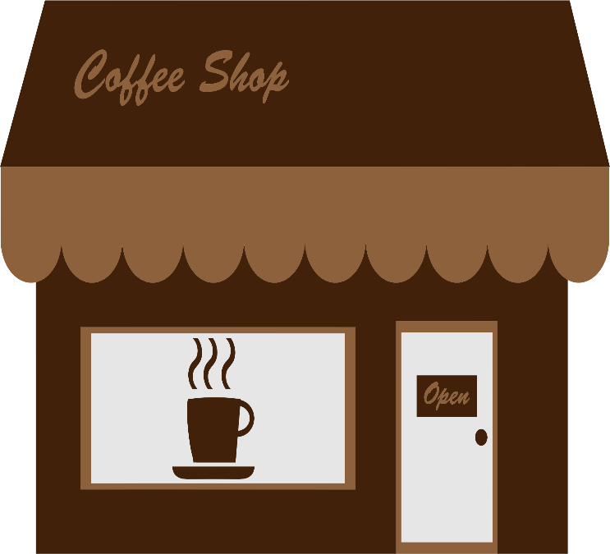
For further details or to plan your visit: Address: Bhola, Barishal Phone: 017488****** Email: jihanalisa2000@gmail.com Website: Coffee house Feel free to reach out or drop by anytime. We look forward to welcoming you!
CONTACT INFORMATION

Slide 8

In today's bustling world, finding a serene spot to unwind with a quality cup of coffee is invaluable. Lisa's Latte Lounge offers not just exceptional beverages and delectable treats but also a haven for relaxation and connection. By prioritizing sustainability and community engagement, it stands out as a coffee shop that truly cares.
Final thoughts

Slide 9
